Slide 1
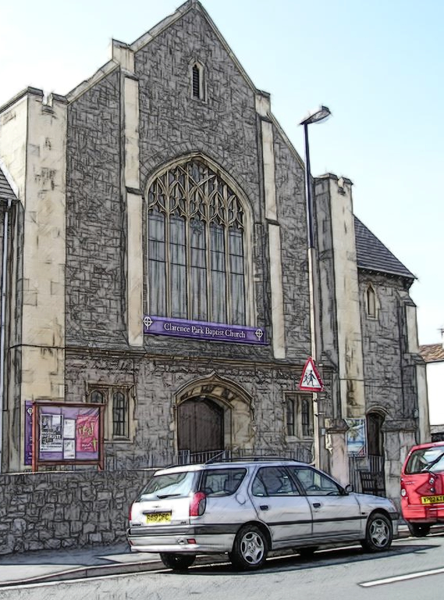
Welcome to
Clarence Park Baptist Church
“We seek to bring people to Jesus, and together grow in our relationship with God and each other as we serve the community.”
www.cpbc.co.uk
WORSHIP God GROW Together SERVE Others

Slide 2
Thank you for joining
with us today
If you would like to contact
the church please
email us using connect@cpbc.co.uk
Or send us a message
through our website
www.cpbc.co.uk
WORSHIP God GROW Together SERVE Others

Slide 3

We are so glad you joined us today!
Please sign our Visitors Book in the entrance and take our greetings to your home church.
WORSHIP God GROW Together SERVE Others

Slide 4

An induction loop system is provided.
Please switch
your hearing aid
to the ‘T’ Position
for reception.
WORSHIP God GROW Together SERVE Others

Slide 5


Welcome to Clarence Park Baptist Church
This service will be live-streamed
If you do not consent to being filmed,
then please ensure that you are sitting
in the back 2 rows or in the balcony.
(This will ensure you are outside of the filming zone)
Please speak to one of the Safeguarding team
if you are unsure of what to do or require further information
WORSHIP God GROW Together SERVE Others

Slide 6

Why not join us
for a cuppa
after the
Morning service
WORSHIP God GROW Together SERVE Others

Slide 7




CLARENCE PARK BAPTIST CHURCH
4 Ways you can give financially
to the ministry and work of our church.
ON-LINE BANKING | REGULAR GIVING | CASH | POST
Sort Code 40-52-40 Account Number 00035721 | Please pick up a standing order form or email office@cpbc.co.uk | Please use the trays/ bags when the offering is taken during the service. | By CHEQUE Payable to: ‘Clarence Park Baptist Church’ To Clarence Park Baptist Church, Walliscote Road, Weston-super-Mare, North Somerset BS23 1ED

Slide 8




c
 | Like our Facebook Page Clarence Park Baptist Church
 | Request to join our Facebook Group Clarence Park Baptist Church
 | Visit our website www.cpbc.co.uk
 | Watch online ClarenceparkTV
o
n
n
e
c
t

Slide 9
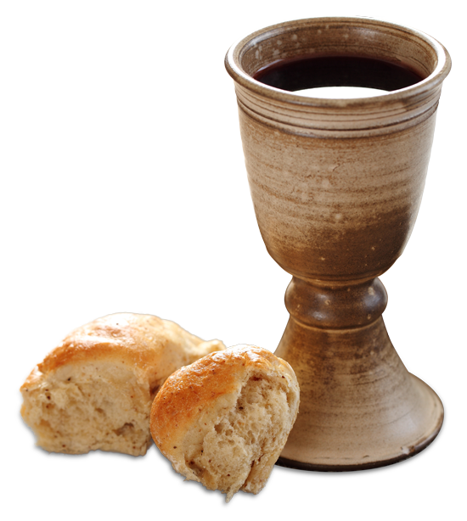
COMMUNION
Please note that On Sundays
we serve Non-Alcoholic Wine and Gluten & Wheat Free Bread

Slide 10

Please would you ensure that your mobile phone is switched
OFF
during the service
Thank you.

Slide 11
Caprione Choir
Practice Dates
Every Tuesday
during term-time
At 7.30pm in the Rear Hall
If you would like to join the group then please speak to Kaye Cooke
or telephone 01934 625788

Slide 12


“THE CLANGERS”
Clarence Park Baptist Church Handchimes group
Practice Dates
2nd and 4th
Thursdays of the month
At 7.30pm in the Primary room
(use the North Entrance)
If you would like to join the group then please speak to Jane Ridge

Slide 13



Tots and Toddlers
Our Tots and Toddler group meets on a Thursday
morning during term time from 10 - 11:30am.
We cater for children from 0-4 years
Parents, grandparents and child minders
  are all welcome to come to our meetings.
  A small charge is made which
  Includes a drink and biscuits
  for both children and adults.

Slide 14


Slide 15

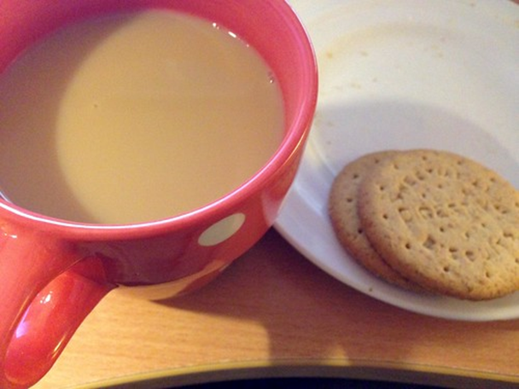
Community
Coffee Morning
Thursdays 9.30-11.30am
Free drinks served ‘til 11.30
All welcome…

Slide 16

Renew 193 is hosted by
Clarence Park Baptist Church,
Milton Baptist Church
and Worle Baptist Church
193 High St, Worle,
Weston-Super-Mare BS22 6JS
For more information
email: renew193worle@gmail.com
www.renewwellbeing.org.uk
    Monday 10am-12noon
    Tuesday 10am-12noon & 2pm-4pm
    Wednesday 10am-12noon & 2pm-4pm
    Thursday 2pm-4pm
(Closed on Bank Holidays)
Are you feeling low? Anxious? Lonely? Isolated?
Do you want to improve your wellbeing and mental health?
Come along, slow down or bring and share a hobby if you wish.
Craft resources/activities are available and free.
You are welcome to relax and enjoy peace in our quiet/ prayer space.
Pop in or come along for the whole 2 hours.
Always a kind welcome, a good cuppa and someone to listen.

Slide 17

Join With Others In the sanctuary
7:30 - 8:30 pm 3rd Thursday of the Month
Praying For The Church, Our Community, Our Nation, The World And For One Another

Slide 18

Join with others for
Topical Bible Discission, Fellowship and Prayer
Meeting in the church 10.30 am to 12:00 noon
2nd and 4th Wednesday of the month
For further information speak to Keith or Judith Newport

Slide 19


BMS Birthday
Scheme
We are thankful for to all those who have given to the BMS Birthday scheme in the past.
If you would like to join us in raising funds for BMS in this way please speak to Julie Dawkins or email Julie.Dawkins@cpbc.co.uk

Slide 20

Looking to connect with others and together learn to walk closer with Jesus in 2024?
Join our new small group meeting monthly at 7.30pm,
Location - ‘Windyridge, 37 Cecil Road.
For more information speak to John Dawkins or Kaye Cooke

Slide 21

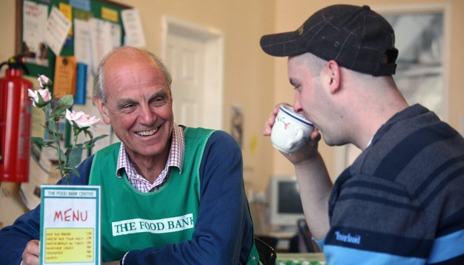
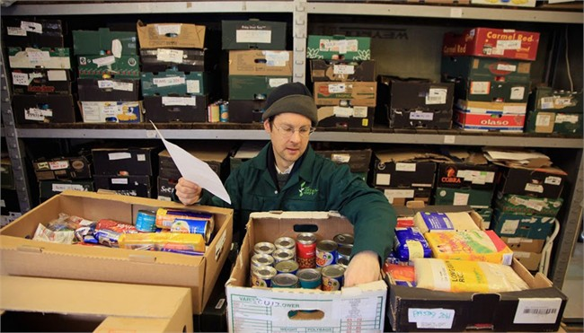
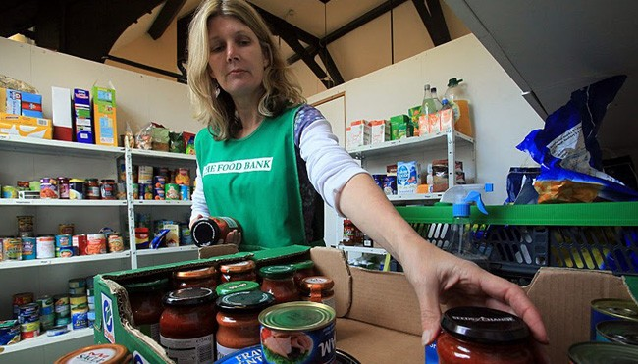
Can you help
Weston foodbank
By providing the following items
UHT and Powdered milk
Cereals
Sugar
Pasta sauces
Tinned Vegetables
Tinned tomatoes
Donations can be made via the box in the church foyer
Foodbank is a registered charity in England And Wales.
Charity Number 1110522 - Reg. Ltd.
Co. Number: 5434524 - Reg. in England & Wales

Slide 22

Communion Offering:
Mar: Home For Good
April: Agape Fund
May: Weston Street Pastors
January Somewhere To Go
Feb Agape
Mar Home for Good
Apr Agape Fund
May Weston Street Pastors
June Agape Fund
July Weston Food Bank
August Agape Fund
September Operation Agri Harvest Appeal
October Agape Fund.
November Christians Against Poverty
December Agape Fund

Slide 23

20th Jan – Harvest – Maureen Price
3rd Feb – Making Feature Film – Marion Robinson
17th Feb – Preparation for service on 25.3.25
3rd Mar – Favourite Hymns – Members
17th Mar – Afternoon Tea
7th Apr – Bay Tree School – Ruth Fuller
28th Apr – Bible Characters – Maureen Price
12th May – Music – Ukulele Group
19th May – Devotional – Liz Squires
2nd Jun – Treasure Hunt – Hilary
16th Jun – Clangers – Jane Ridge
7th Jul – Cricket
21st Jul - AGM
UPCOMING EVENTS
7th April – Bay Tree School
(Ruth Fuller)
28th April – Bible Characters
(Maureen Price)

Slide 24


CPBC
Spring Clean
Fri 4 April
10 – 1pm

Slide 25

February Tuesday 18th ..7pm..Esther from WESTON HOSPICECARE re £340 donation…. + KILLER SKITTLES for the “One ball trophy”…. At Coach House Locking… …..+ 2 course “Hot Food”.... £11.00…
.
MARCH..Tuesday18th...7pm….SKITTLES CHALLENGE!!… for the “Wonky Skittle Trophy” +2 course “Hot Food”..... £11.00 at The Coach House Locking…
APRIL….. Saturday 5th…… 9am…PRAYER BREAKFAST at C.P.B.C…. £5 …….Keith Newport… Tuesday 15th… 6.30pm .. OUTSIDE VISIT…. BANWELL FIRE STATION …. 7.45pm 2 course “Hot Food”.. £11.00 at The Coach House Locking + KILLER SKITTLES for the “One ball trophy”….
MAY…. Tuesday 20th .. 7pm COCO International BUFFET in James Street …. £19.99
JUNE…. Tuesday 17th …. 7pm… BBQ……Ray Thomas…….£5….. Venue…. 10 Manor Grange, Bleadon WsM BS24 0QJ… …..“Hoop La 10” Challenge Trophy….. ………… Bring your own liquid refreshment……………………PTO
JULY…… Saturday 5th …..9am…..PRAYER BREAKFAST at C.P.B.C.. £5….Kevin Speakman. Tuesday 15th……..6.30pm.. LAWN BOWLS at Clarence Bowling Club….. ..Green fees and refreshments afterwards…..£10
AUGUST…… Tuesday 19th….. 7pm….BBQ……. Hugh Weeks……….. £5…… ….”BRING A FRIEND NIGHT” +.. “Hoop La 10” Challenge Trophy…… Venue…. 11 Clifton Road WsM BS23 1BJ…. ………….. Bring your own liquid refreshment……………….
SEPTEMBER….. Tuesday 16th… 7pm….CURRY NIGHT….ZAC’S..Whitecross Rd.. WSM. (Hopefully 3 courses £15.95 ).....corkage free……
OCTOBER…. Saturday 4th……9am.. PRAYER BREAKFAST at C.P.B.C £5 …. Ray Thomas.
Tuesday 21st….. 7pm.. TALK…Steve Christian…….Coach House Locking.. +Hot Food…. 2 courses £11….Plus ”Killer Skittles” for the “One Ball Trophy”
NOVEMBER….. Tuesday 18th…. 7pm…..QUIZ…..Kevin Speakman … Coach House Locking .. +Hot Food …2 courses £11….. Plus …”Killer skittles”for the “One Ball Trophy”.....
DECEMBER… Saturday 6th…… 9am….PRAYER BREAKFAST at C.P.B.C. £5 ….. Peter Price...
Tuesday 16th….. 7pm.. CHRISTMAS MEAL… TO BE ANNOUNCED..... £ ?
Clarence Park Baptist Church
MEN’S Group
Meet the
3rd Tuesday
of every month
Coming up….
Saturday 5th April at 9am – Prayer Breakfast £5 Tuesday 15th April @ 6.30pm Outside visit to Banwell Fire Station 7.45pm 2 course meal at The Coach House Locking + Killer Skittles for the ‘One Ball Trophy’ . £11.00
Please contact Michael Wedlake on 07516460348 for any clarification of dates, times, lifts needed etc….or via the church office@cpbc.co.uk

Slide 26
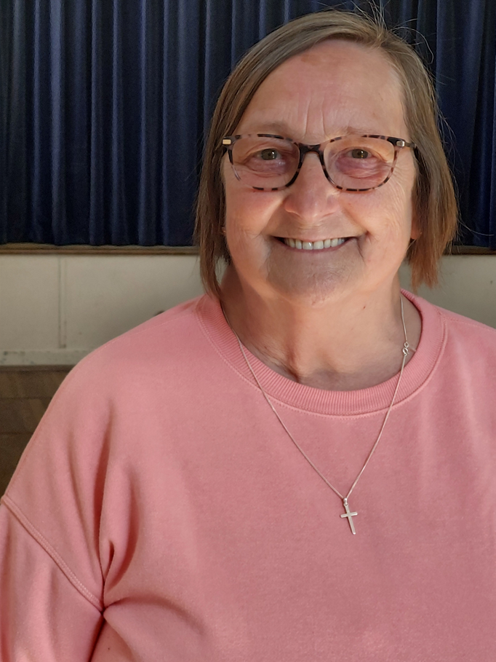

Jacky will be 70!
……
Celebrate on
Sunday 6 April
12.30 – 2.30
CPBC church hall
…….
Bring & Share lunch
RSVP to Jacky, or use sign-up
sheet at church

Slide 27


Meet and Mix
All welcome
Details - Su 0791 646 1442
Sat 12 April: Bus to Burnham on Sea
Bus 20 - Leave 11.05am. Return by 5pm
Bring or buy own food/drink

Slide 28
Deacons’ Election
Church AGM April 27th 2025
5
This year there are vacancies
Please prayerfully consider who God may be calling to this important role
Nomination Forms are available from Julie Dawkins
Deadline for nominations is Sunday April 6th

Slide 29


Slide 30


Slide 31


Slide 32

Don’t forget to pick up your notice sheet in the foyer,
which lists activities taking place
or find a copy
on the church website.
If you are holding activities which you want included in the notice sheet please speak to Julie Dawkins
WORSHIP God GROW Together SERVE Others

