Slide 1
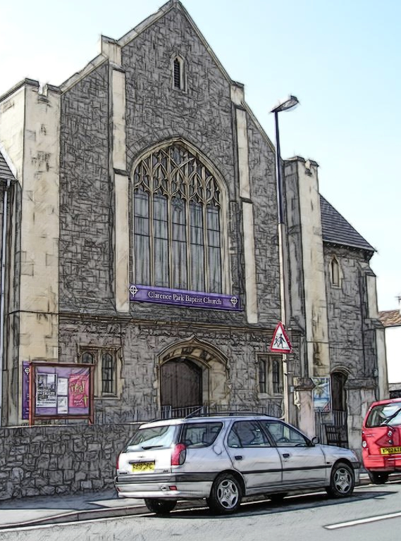
Welcome to
Clarence Park Baptist Church
“We seek to bring people to Jesus, and together grow in our relationship with God and each other as we serve the community.”
www.cpbc.co.uk
WORSHIP God GROW Together SERVE Others

Slide 2
Thank you for joining
with us today
If you would like to contact
the church please
email us using connect@cpbc.co.uk
Or send us a message
through our website
www.cpbc.co.uk
WORSHIP God GROW Together SERVE Others

Slide 3

We are so glad you joined us today!
Please sign our Visitors Book in the entrance and take our greetings to your home church.
WORSHIP God GROW Together SERVE Others

Slide 4

An induction loop system is provided.
Please switch
your hearing aid
to the ‘T’ Position
for reception.
WORSHIP God GROW Together SERVE Others

Slide 5


Welcome to Clarence Park Baptist Church
This service will be live-streamed
If you do not consent to being filmed,
then please ensure that you are sitting
in the back 2 rows or in the balcony.
(This will ensure you are outside of the filming zone)
Please speak to one of the Safeguarding team
if you are unsure of what to do or require further information
WORSHIP God GROW Together SERVE Others

Slide 6

Why not join us
for a cuppa
after the
Morning service
WORSHIP God GROW Together SERVE Others

Slide 7




CLARENCE PARK BAPTIST CHURCH
4 Ways you can give financially
to the ministry and work of our church.
ON-LINE BANKING | REGULAR GIVING | CASH | POST
Sort Code 40-52-40 Account Number 00035721 | Please pick up a standing order form or email office@cpbc.co.uk | Please use the trays/ bags when the offering is taken during the service. | By CHEQUE Payable to: ‘Clarence Park Baptist Church’ To Clarence Park Baptist Church, Walliscote Road, Weston-super-Mare, North Somerset BS23 1ED

Slide 8




c
 | Like our Facebook Page Clarence Park Baptist Church
 | Request to join our Facebook Group Clarence Park Baptist Church
 | Visit our website www.cpbc.co.uk
 | Watch online ClarenceparkTV
o
n
n
e
c
t

Slide 9
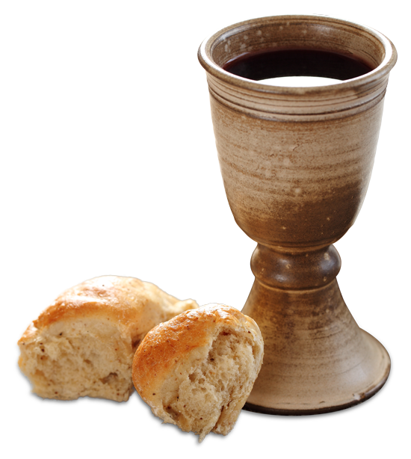
COMMUNION
Please note that On Sundays
we serve Non-Alcoholic Wine and Gluten & Wheat Free Bread

Slide 10
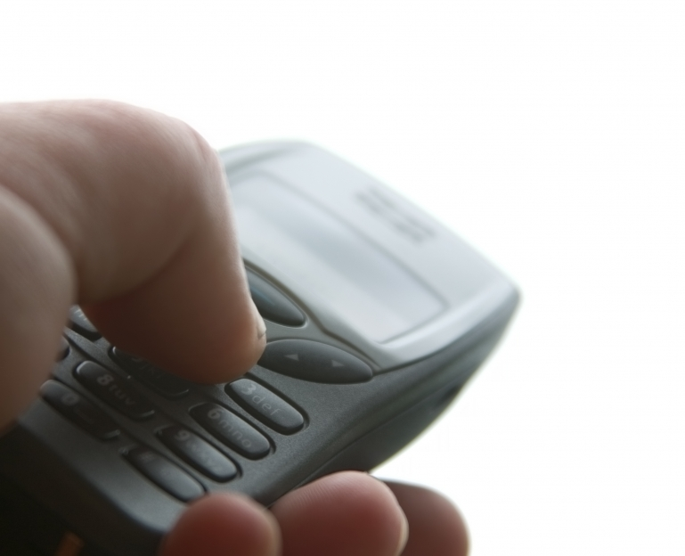
Please would you ensure that your mobile phone is switched
OFF
during the service
Thank you.

Slide 11
Caprione Choir
Practice Dates
Every Tuesday
during term-time
At 7.30pm in the Rear Hall
If you would like to join the group then please speak to Kaye Cooke
or telephone 01934 625788

Slide 12


“THE CLANGERS”
Clarence Park Baptist Church Handchimes group
Practice Dates
2nd and 4th
Thursdays of the month
At 7.30pm in the Primary room
(use the North Entrance)
If you would like to join the group then please speak to Jane Ridge

Slide 13



Tots and Toddlers
Our Tots and Toddler group meets on a Thursday
morning during term time from 10 - 11:30am.
We cater for children from 0-4 years
Parents, grandparents and child minders
  are all welcome to come to our meetings.
  A small charge is made which
  Includes a drink and biscuits
  for both children and adults.

Slide 14

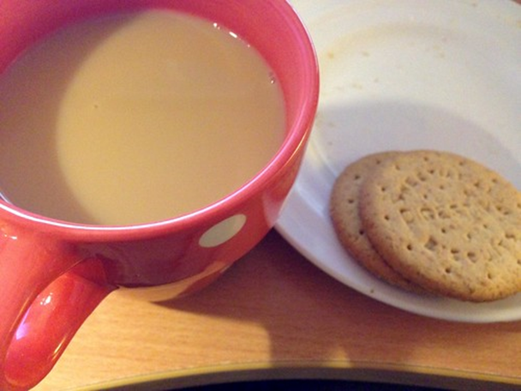
Community
Coffee Morning
Thursdays 9.30-11.30am
Free drinks served ‘til 11.30
All welcome…

Slide 15

Sew
Clarence Park Baptist Church
CRAFT GROUP
FRIENDSHIP CRAFTS COFFEE CHAT
Crafty
2nd & 4th Saturdays of the month @ 10:00am
£2.00 per session to cover equipment and materials
Open to all Women and Men whatever ability and experience.
Please feel free to bring your own projects to work on.
The groups project is to work for a sale for charity.

Slide 16
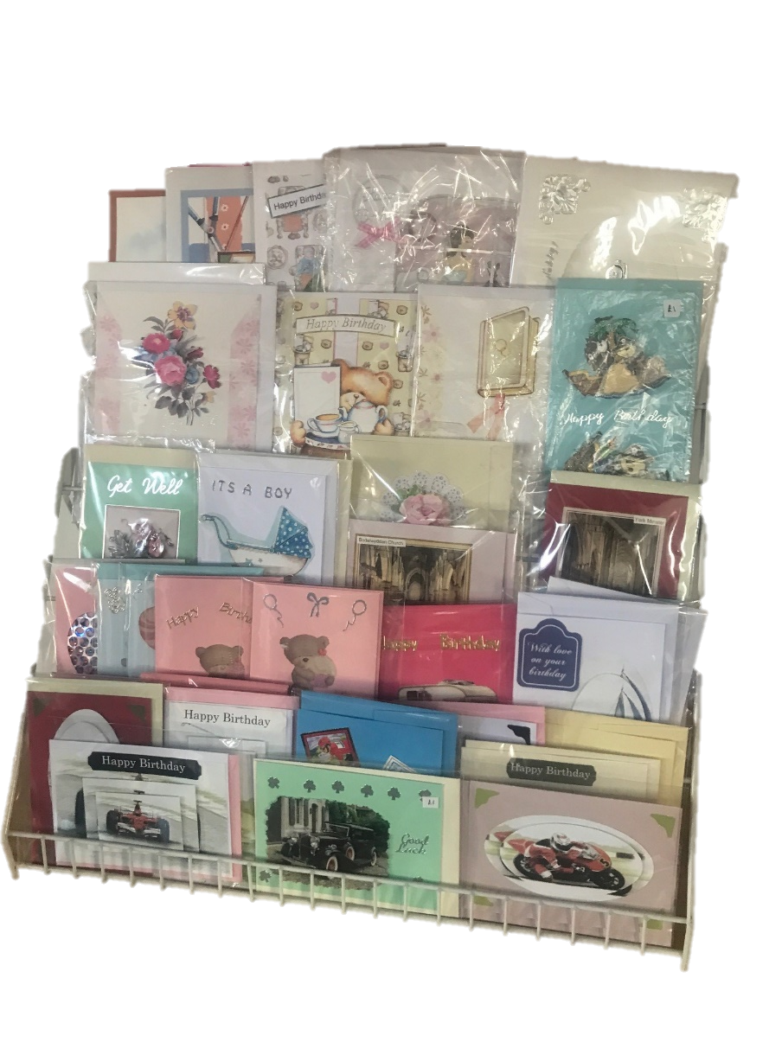
Sew
Clarence Park Baptist Church
CRAFT GROUP
FRIENDSHIP CRAFTS COFFEE CHAT
Crafty
A Selection Of Hand Made Cards Are Available
For Sale In The Church Foyer

Slide 17

Renew 193 is hosted by
Clarence Park Baptist Church,
Milton Baptist Church
and Worle Baptist Church
193 High St, Worle,
Weston-Super-Mare BS22 6JS
For more information
email: renew193worle@gmail.com
www.renewwellbeing.org.uk
    Monday 10am-12noon
    Tuesday 10am-12noon & 2pm-4pm
    Wednesday 10am-12noon & 2pm-4pm
    Thursday 2pm-4pm
(Closed on Bank Holidays)
Are you feeling low? Anxious? Lonely? Isolated?
Do you want to improve your wellbeing and mental health?
Come along, slow down or bring and share a hobby if you wish.
Craft resources/activities are available and free.
You are welcome to relax and enjoy peace in our quiet/ prayer space.
Pop in or come along for the whole 2 hours.
Always a kind welcome, a good cuppa and someone to listen.

Slide 18

Join With Others In the sanctuary
7:30 - 8:30 pm 3rd Thursday of the Month
Praying For The Church, Our Community, Our Nation, The World And For One Another

Slide 19

Join with others for
Topical Bible Discission, Fellowship and Prayer
Meeting in the church 10.30 am to 12:00 noon
2nd and 4th Wednesday of the month
For further information speak to Keith or Judith Newport

Slide 20


BMS Birthday
Scheme
We are thankful for to all those who have given to the BMS Birthday scheme in the past.
If you would like to join us in raising funds for BMS in this way please speak to Julie Dawkins or email Julie.Dawkins@cpbc.co.uk

Slide 21

Looking to connect with others and together learn to walk closer with Jesus in 2024?
Join our new small group meeting monthly at 7.30pm,
Location - ‘Windyridge, 37 Cecil Road.
For more information speak to John Dawkins or Kaye Cooke

Slide 22

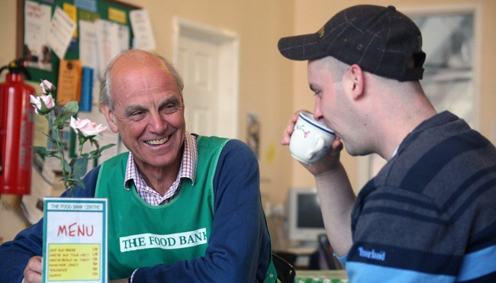
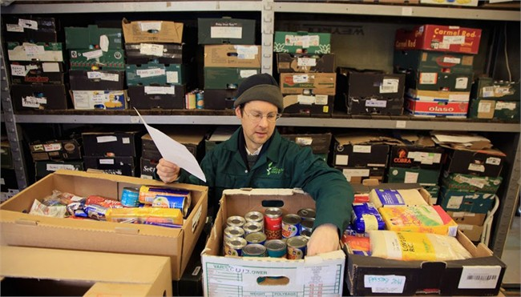
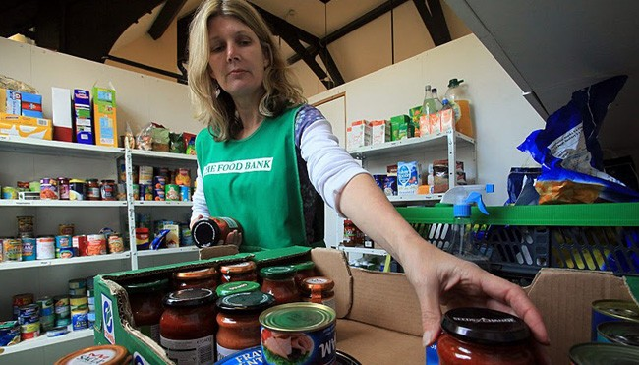
Can you help
Weston foodbank
By providing the following items
UHT and Powdered milk
Cereals
Sugar
Pasta sauces
Tinned Vegetables
Tinned tomatoes
Donations can be made via the box in the church foyer
Foodbank is a registered charity in England And Wales.
Charity Number 1110522 - Reg. Ltd.
Co. Number: 5434524 - Reg. in England & Wales

Slide 23

Communion Offering:
Dec: Agape Fund
Jan: Somewhere To Go
Feb: Agape Fund
Mar: Home For Good
January Somewhere To Go
Feb Agape
Mar Home for Good
Apr Agape Fund
May Weston Street Pastors
June Agape Fund
July Weston Food Bank
August Agape Fund
September Operation Agri Harvest Appeal
October Agape Fund.
November Christians Against Poverty
December Agape Fund

Slide 24


Slide 25

7th Oct - Scripture Market
21st Oct Nursery Rhymes – Maureen Price
4th Nov – Baptist Woman’s Day of Prayer
18th Nov First Aid – Alex Mackintosh
2nd Dec Devotional – Mary Jeremy
16th Dec Christmas Flowers – Pat Porter
UPCOMING EVENTS
16th Dec – Christmas flowers
(Pat Porter)

Slide 26

Clarence Park Baptist Church
MEN’S Group
Meet the
3rd Tuesday
of every month
Coming up…. CHRISTMAS MEAL 7pm Tuesday 17th Dec at The Woolpack £23.95 for 3 courses. Please indicate your meal choices at the coffee point and pay your £5 deposit to Michael asap.
Jul 16th 6.30pm Lawn Bowls at Clarence Bowling Club
Green fees and refreshments afterwards £10
Aug 20th 7pm BBQ Hugh Weeks £5 Bring your own liquid refreshments
Oct 5th Mens Breakfast £5
15th 7pm Skittles at The coach House, Locking + Hot Food £7.50
Nov 19th 7pm Quiz Kevin Speakman The coach House, Locking + Hot Food £7.50
Dec 17th Christmas Meal of the month.
Ray Phone 07565592933
Michael 07516460348
For further details please contact
Ray Thomas via the church office@cpbc.co.uk

Slide 27



Fellowship
Christmas Party
New Year Party
Saturday 4th January 2-5pm
Bring and Share Tea
Please sign up at the coffee point particularly giving details of any children.

Slide 28

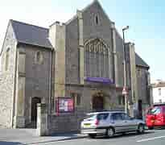
Sunday 19th January
After a Bring and Share lunch
Please join us as we meet again with our regional minister Gary Woodall and work towards discerning what God has planned for us as a church

Slide 29


Slide 30


Slide 31

Don’t forget to pick up your notice sheet in the foyer,
which lists activities taking place
or find a copy
on the church website.
If you are holding activities which you want included in the notice sheet please speak to Julie Dawkins
WORSHIP God GROW Together SERVE Others

